Slide 1
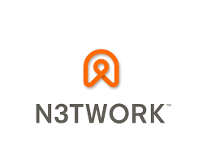
TRENDING APPS DETECTION
Kate Mizgireva • Katie Balcewicz • Zach Kidd
Data Science Data Science Data Science
MUSC Data Science Intern Office of Admissions Student Student
Data model Builder

Slide 2
PROJECT DESCRIPTION
Web-scrape data from Apple and Android App Stores
Upload into MongoDB and process the data
Detect the outliers in trends
Build predictive model on apps that will trend in future
Implement a script to send a daily e-mail
Implement daily Bash scripts to collect the data

Slide 3










TECHNOLOGIES USED
repository, scrum management communication, updates, tracking database
storage, hosting virtual machine web scraping
daily scripts main scripts predictive modeling data collections

Slide 4
PROJECT PIPELINE
Web-scrape using node.js
Upload Data into Google Cloud
Load into MongoDB
Build Pandas DataFrames
Predict trending apps using outlier detection

Slide 5
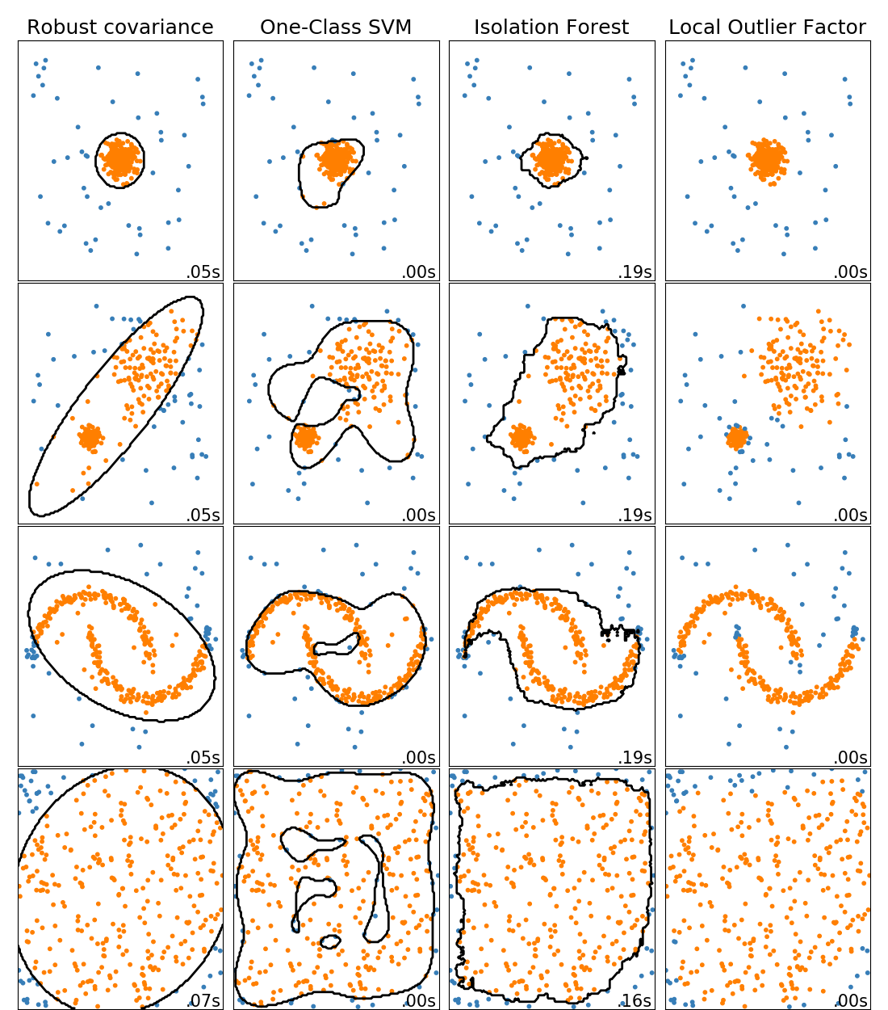
OUTLIER DETECTION ALGORITHMS

Slide 6
PROJECT PIPELINE
Sprint 1: Zach (1/31-2/26) web-scrap the data, put it into database, design the database architecture
Sprint 2: Kate (2/27-4/1) Create dataframes, model the data, build predictive models
Sprint 3: Katie (4/2-5/2) Wrap up, combine python scripts into one, build e-mail script

Slide 7
Challenges and triumphs
Incorrectly formatted Json files
Bug in Google Play scraper
Learning many new technologies

Slide 8
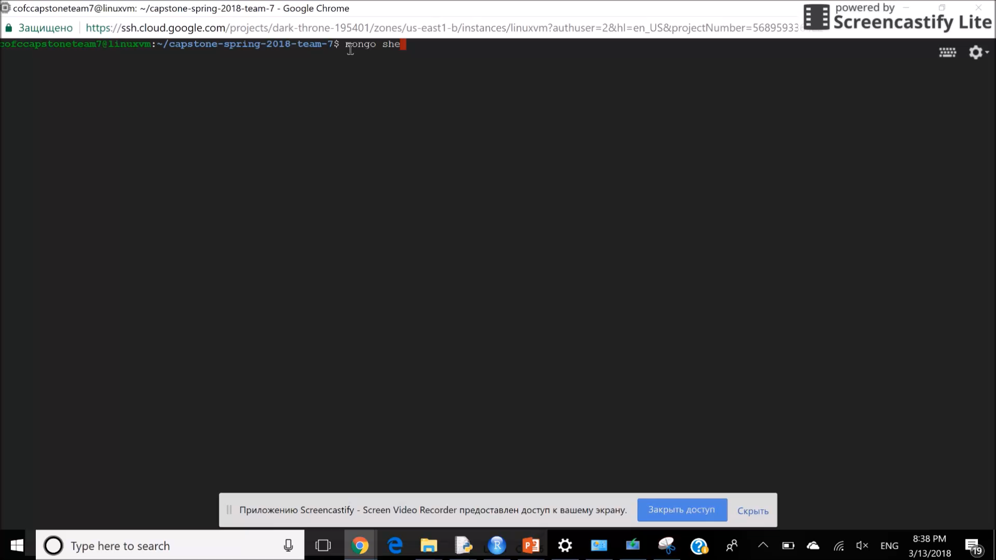

Slide 9
Thank you for your Attention

